Slide 1

Nuclear Island:
Securing Funding for STEM Projects
Dr Caroline Sudworth
Manager: HE Engagement
Cogent

Slide 2

Future Power: Nuclear New Build
Next Generation:
Skills for New Build Nuclear
March 2010

Slide 3
Future Power: Nuclear New Build

Slide 4
Future Power: Nuclear New Build

Slide 5
Future Power: Nuclear New Build
NEW ENTRANTS per annum:
Sector Attraction and Retirement Rate
Construction (Mechanical and Electrical)
1800 graduate level +
7200 technical level
3000 lower level
Operation
2250 graduate level +
2000 technical level
750 lower level
Manufacture
200-400 graduate level +
300-400 technical level
150-350 lower level

Slide 6




Finding a Solution for Nuclear New Build

Slide 7






Research & Engagement
Research
Industry Needs
Curriculum
Delivery Method
Behaviours
Support
Engagement Solution
Sector Approach
Partnerships
Risk Reduction

Slide 8
Delivering the Solution:
Industry Engagement
Pilot Nuclear Island Constructionarium
  Design
  Curriculum
  Nuclear Behaviours
  Extra-curricular activities
  Feedback for future cohorts
Supporting Partners
  CPD Packages
  Employer Support
  Academic Support

Slide 9
Nuclear Island: The Future
Academic Partners
  Expand pilot packs
  Run a week long programme
  Feed back on additional needs and learning for all parties
  Specialities added (wider STEM remit)
Self supporting module delivered
Ensure employer buy in on large scale to support and sustain programme

Slide 10


Academic Partnerships:
Transfer Good Practice; Deliver Graduates

Slide 11











Employer Partnerships:
Minimise Risk; Ensure Sustainability

Slide 12
Nuclear Island: Critical Success Factors
Clarity on Skills
Need identified
Solution identified
Fast turnaround
Funding
Clear Skills Need
Best practice transferred
Project Phased and Progression Communicated
Clear Deliverables and Timescales
Relationships for Sustainability
Shared Risk
Resource for the Future
Value for Money
Partnerships
Built on existing relationships
Communication
Expectation Management
Clear Deliverables
Sustainability
Risks Reduced

Slide 13
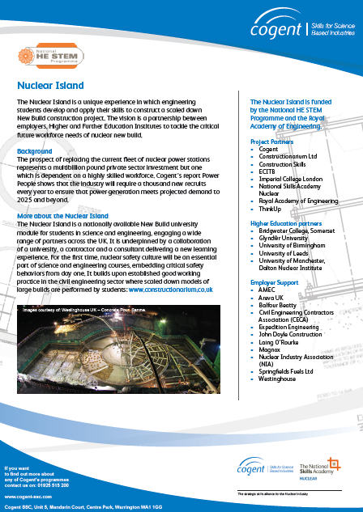
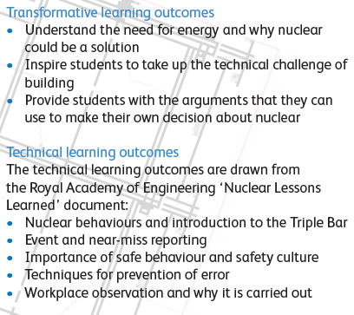
More Information
www.cogent-ssc.com/Higher_level_skills/ni_index.php
Caroline Sudworth: caroline.sudworth@cogent-ssc.com

