Slide 1

An Alternative Route into Research
- The Science Apprenticeship Scheme at Novartis
Emma Budd
18th October 2010

Slide 2
Presentation Content
Introduction to Novartis
Science Apprenticeship Scheme Background
The Process: A two part scheme
- Educational and Mentoring
Achievements
- Why does Novartis value this training
- Why do the Apprentices value this alternative route
Conclusions
- What return does Novartis achieve on this alternative
recruitment pathway and requirements for continued success
Science Apprenticeships| Emma Budd| 18-Oct-2010

Slide 3
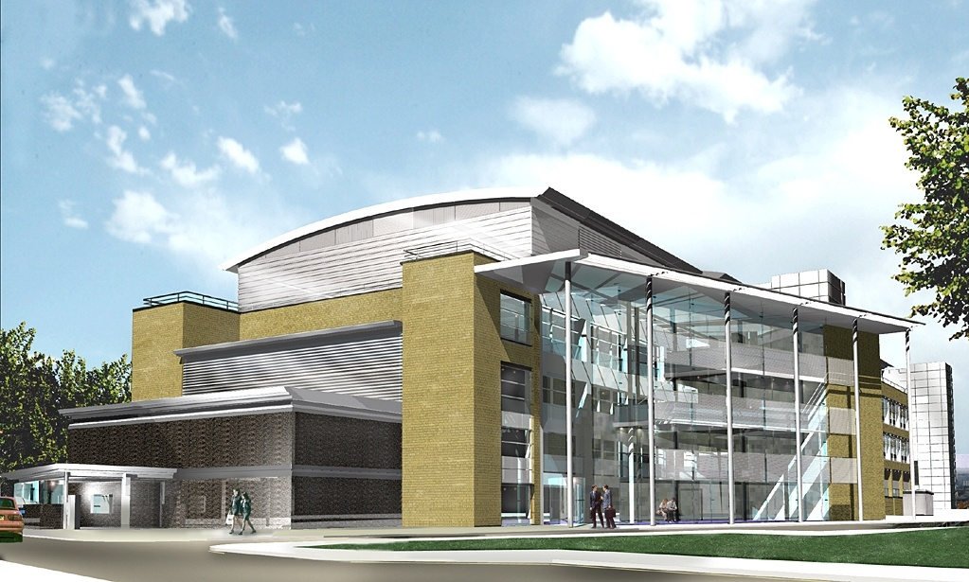
Who are we?
The Novartis Institute of BioMedical Research (NIBR)
Novartis has a strong commitment to R&D with research centres in Switzerland, UK, USA and China
Novartis Horsham Research Centre in Horsham, is home to NIBR in the UK
Respiratory and Gastro-intestinal Research
Houses 400 scientists of graduate level or above

Slide 4
Scientific Apprentice Scheme Background
Apprenticeship Scheme was initiated in 2000 within Research
Opportunity for 1 chemistry and 1 biology Apprentice each year
- Minimum two A‘levels in appropriate subjects accepted
- Essential to source a University place
Currently 8 apprentices on scheme
    5 undergraduate (2 Biology, 3 Chemistry)
    3 pre-HNC (1 Biology, 2 Chemistry)
  First two graduated in 2005.
  Thereafter steady state of 8-10 apprentices as studies are completed
  Advertise in March for a September start date

Slide 5
Scientific Apprentice Scheme Background
Target local schools/colleges to recruit suitable candidates
- letter and job advertisement sent directly
- career days and presentations
Further education funded by Novartis
- includes travel allowance, books and all fees
Expanded scheme to include Pharmaceutical Operations in 2005
- Used Research model and evolved it for Operations specific needs
- Recruited 1 chemistry apprentice for QC labs
Science Apprenticeships| Emma Budd| 18- Oct-2010
Notes:
.

Slide 6
The Process – A two part scheme
Education by part-time study
  A’ level to HNC/Foundation degree (Greenwich/NESCOT)
  HNC/Foundation to BSc
Skills training
  Rotation through different labs for initial 42 months
  Lab assignment for 18 months whilst completing degree
  Consolidation of key skills in area of interest
Fixed term contract linked to day release course
  Currently 2 years until HNC achieved then 3 years for the BSc
    - Success completing HNC results in promotion
    Option to terminate employment at end of each contract
    Opportunity for apprentice to opt out

Slide 7
The Process – General Skill Development
Apprentices will receive training in:
  IT and computer skills
  Health and safety
  Risk assessment
  Laboratory data recording and management
  Presentation and communication skills
  Time management and organisation
Apprentices will develop:
  Confidence
  Team working skills
  Strong communication techniques

Slide 8
The Process - Core Chemistry Skills
Foundation
Course
Combinatorial and
library synthesis
Advanced
Organic Synthesis
Computer Aided
Drug Design
MEDICINAL
CHEMISTRY
Synthetic Support
and
Scale up
Organic Synthesis
Metabolism
and
Pharmacokinetics
Advanced Analytical Chemistry

Slide 9
The Process – Core Biology Skills
Laboratory placements for 6-9 months
Foundation and Biochemistry : Cell Culture
Primary Assay
Drug Metabolism, Pharmacokinetics : In-vitro Screening
Automated Assay
Pharmacology : In-vitro
In-vivo
Histology
Molecular and Cell Biology : PCR
Baculovirus Technology
Genetic Engineering
Notes:
9

Slide 10
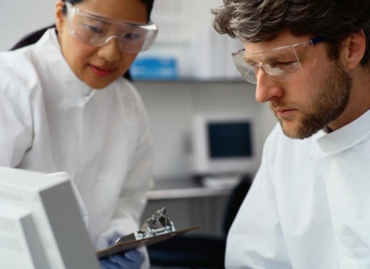

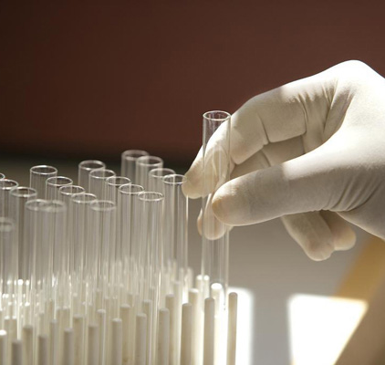
Achievements : Why does Novartis value this training
Calibre and diversity of graduates recruited
from scheme is excellent
- Strong practical and problem solving skills
  - Difficult positions have been filled
  - No further training is needed
  - These graduates can train new staff members
Supervisors have developed new skills
  - Improvement in mentoring and coaching
  - Opportunities to develop
  - Motivational experience
  On successful completion options are:
    - Progress onto next apprentice level
    - Employ on Graduate grade
    - Terminate employment

Slide 11
Achievements : Why do the apprentices value this training
  Alternative route into Pharmaceutical Research
  - Relevant practical training complemented by a degree
  - Highly motivating
  - Acquire a unique skill set through rotations
  - Earn while you learn
  Interpersonal skill development
  - Communications and confidence
  - Innovation and creativity encouraged
  - Coaching and supervisory skills developed
  On successful completion career options are:
    - Progress to full-time Graduate grade
    - Move on to PhD
    - Career break
    - Move to alternative employment

Slide 12
Conclusions
Scheme now fully integrated into the culture. Diverse teams.
Successful training model for a career in Pharmaceutical Research
Mix of skills and expertise shows increase in creativity and innovation
Results in highly motivated and skilled graduates
Sourcing University placements for part-time academic training is
crucial to success of scheme
Novartis feels the vision of a UK science apprenticeship is ambitious
but necessary to ensure that innovative R&D continues to thrive by
attracting and retaining strongly motivated young people

Slide 13
Acknowledgements
Senior Managers:
Vision to support the Scheme at beginning
Julia Hatto and Denise Head:
Responsible for starting the scheme
Apprentices:
For continued feedback
Supervisors:
Particularly of those in the first placement
Teacher-Partner:
John Luton, Varndean

