Slide 1

High Level Apprenticeship in Advanced Manufacturing
Ian Lockhart
Apprenticeship Manager

Slide 2
Project Aim
Work with employers across the advanced manufacturing industries to ensure the solutions are supported by small and medium sized businesses, with an emphasis on working with SME’s in the supply chain to large employers.

Slide 3
Who is leading this Project
Cogent, Proskills, UKCES and IMPROVE
SEMTA are leading this Project.
The HLA will commence in 2012

Slide 4
Employers Taking Part
AIRBUS UK
BAE Systems
GKN
SIEMENS
Pilkington Glass
Walkers Crisps

Slide 5
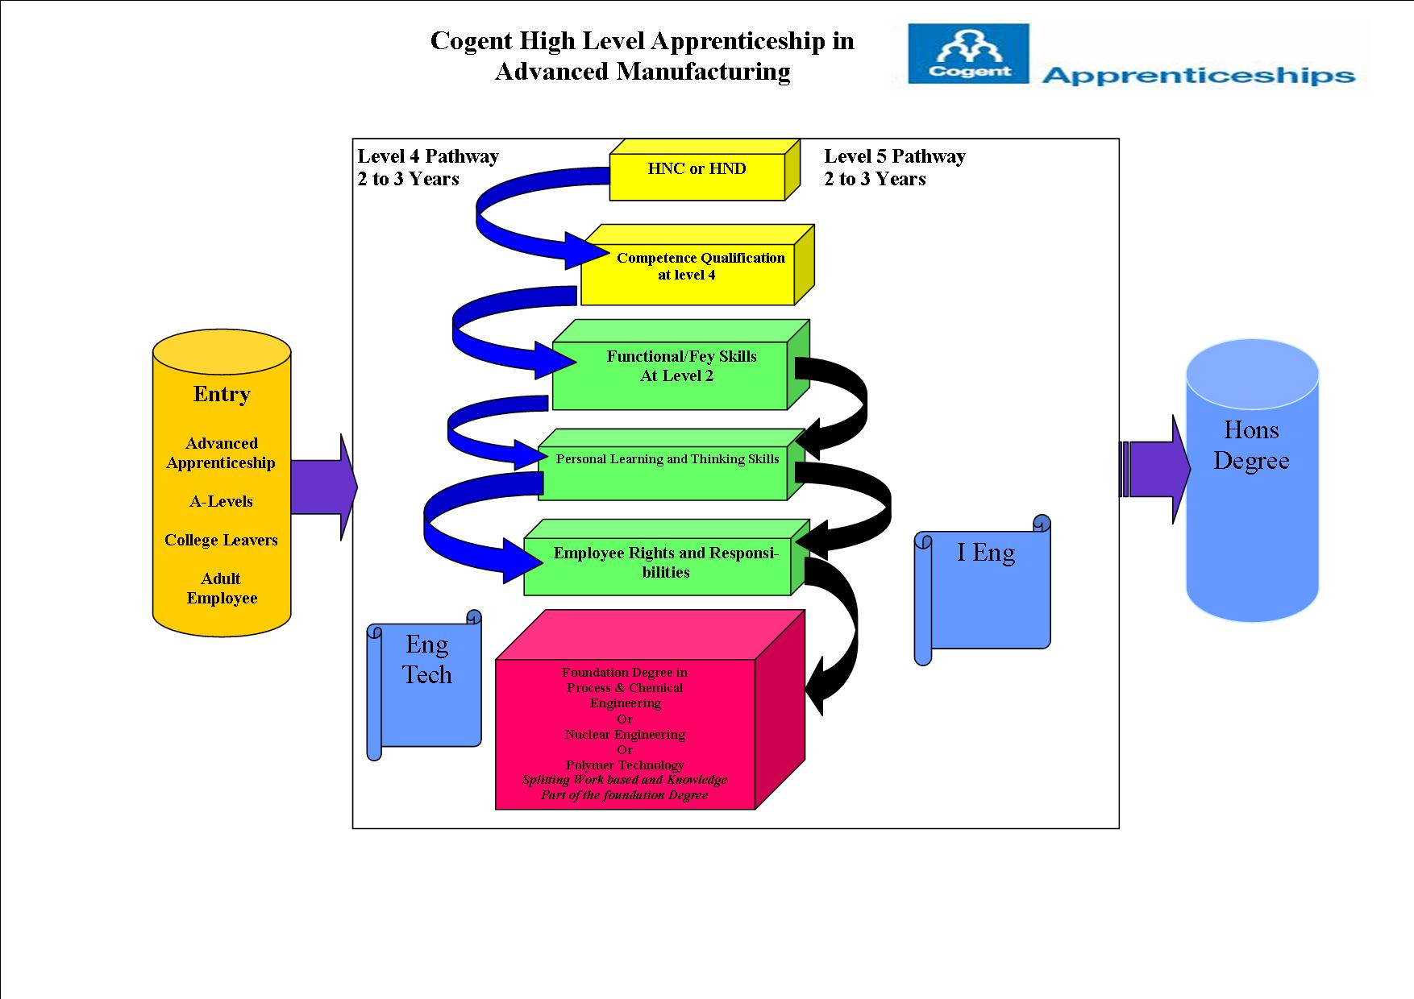
The Cogent Model

Slide 6
Help Needed
We would like your help in developing Cogent Pathways in this
High Level Apprenticeship in Advanced Manufacturing
and attending the employer steering group meetings.
For more information please contact
Ian.lockhart@cogent –ssc.com

