Slide 1

Cogent Qualifications
Jayne Edwards
June 2011

Slide 2
Qualification funding
  Demise of Train to Gain & Sector Compact
  Joint Investment Programme – sector priority qualifications & units in Year 2 **
SFA Guidance Note 7 & 19+ Learner Subsidy paper
  First Level 2 entitlement changes in 12/13; over 25s co-funded
  Additional Level 2s co-funded in 11/12 for SMEs only
  First Level 3 (& jumpers) fully funded in 11/12; change in 12/13 to not funded
  From 2012/13 loans system for Level 3 & above

Slide 3
Funding Changes in the pipeline
GIF JIP – anticipating 2012
Rates determined by SSA & size (unit, award, certificate, diploma)
Size/uplift | Rate A | Rate B | Rate C | Rate D
Unit | £ 155 | £ 174 | £ 201 | £ 248
Award | £ 408 | £ 457 | £ 530 | £ 653
Certificate | £ 798 | £ 894 | £ 1,038 | £ 1,277
Diploma 1 | £ 2,293 | £2,568 | £ 2,981 | £ 3,668
Diploma 2 | £ 4,201 | £4,705 | £ 5,461 | £ 6,722

Slide 4
England update - Oracle Primary LMI
Between 1 and 10 training days were arranged for each employee, both internally and externally
The average training spend per employee was highest for;
  Senior Managers (£850); followed by
  Professional Scientists and Engineers (£650);
  Craft and Technicians (£550); and
  Process, Plant and Machine Operatives (£400)
Notes:
60% of employers stated that ‘competence based skills’ had increased in the 12 months preceding the survey. A slightly lower proportion of employers expected the demand for technical (55%); leadership and management (55%); and professional/higher level skills (40%) to increase in the 12 months following the survey.

Slide 5

England update - Awareness of Cogent
    The careers site gets 4000 unique visitors a month 1500 careers professionals/teachers
Web rankings
  Bis.gov.uk 2,608th
  Cogent 65,748th (+8,000/mth)
  Semta 228,961th
  UKCES 175,337th
  Construction Skills 187,311th
  Ryan Giggs 75,000 in a week

Slide 6
Women & Work
2011/12

Slide 7

Women & Work – What is it?
An opportunity for Women to access the skills development they need to enable progression and/or promotion within the sector
355 development opportunities for women across the UK
£600 cash grant per individual for training under 3 Strands:
  Pre apprentice or advanced technical development
  Generic skills development
  Short course L&M Programmes

Slide 8
Funding Constraints
Employer must make 50% contribution to the ‘total’ costs of training
15% of this cost must be a cash payment to a provider/accreditor of training
Third party accredited in house training is eligible for Women and Work funding

Slide 9
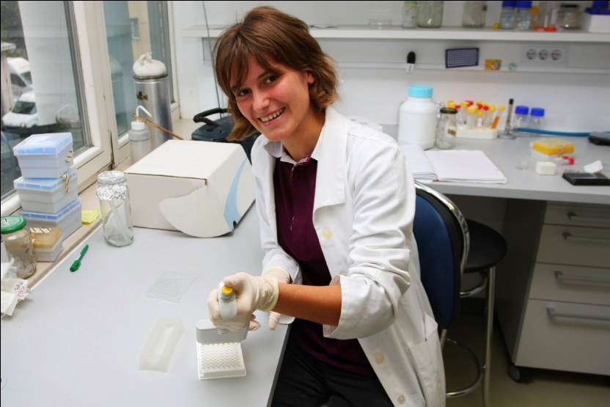
Restrictions
Programmes available via mainstream government funding not eligible
A maximum grant of £600 grant (matched by employers) available per individual
Statutory training obligations not supported
All courses must be completed by end February 2012

Slide 10
Key Documents
Employer and Individual registration details
Beneficiary Training plan
Indicative Training Costs form
Indicative maximum grant form
Completion of Training/Grant Claim form (+ supporting evidence of training having taken place)

Slide 11
Worked example 1
Presentation skills course
Cost of Third Party training: £800
Employee’s time on course (salary): £200
Travel and subsistence: £50
‘In house’ shadowing support: £150
Total training costs £1200
Company Contributions
Potential grant (50% of total costs) £600

Slide 12
Cogent Future Funding
Chemical Advisory Council
June 2011

Slide 13
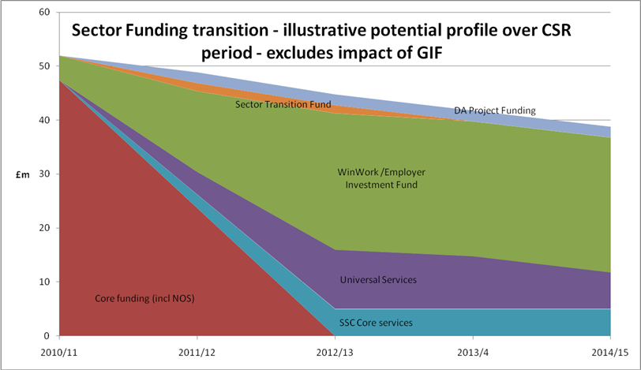
SSC Funding transition

Slide 14
EIF1
Cogent’s 2 bids were successful:
Women and Work £353,225
  355 programmes
Life Sciences SMEs £100,000
  to engage Life Science SMEs in the Gold Standard
  9 month programmes

Slide 15
GIF1
Apprenticeship Training Agency £889,666
  Science industry apprentices from Level 2 to Level 5
SME Gold Standard Skills £612,968
  the development of an online skills assurance process
  the development of an on-line shop
Life Sciences Skills Pathways £890,876
  High Level Apprenticeship frameworks
  Career Pathways
  Technician training
  Employability Kite Marking

Slide 16
EIF2
Process Manufacturing
  Voluntary licence to practice
Life Sciences
  Window on the World
Nuclear
  Supply chain competence
SME’s
  Science Park Skills
Sustainability
  Sustainable business practice

