Slide 1

Career & Training Pathways: towards an Employability Framework for the Biosciences

Slide 2
Life Sciences Skills Pathways
‘Cogent Careers’
Interactive website
  Job profiles
  Entry and skills requirements
  Salaries
  Progression pathways
  Case studies, podcasts

Slide 3
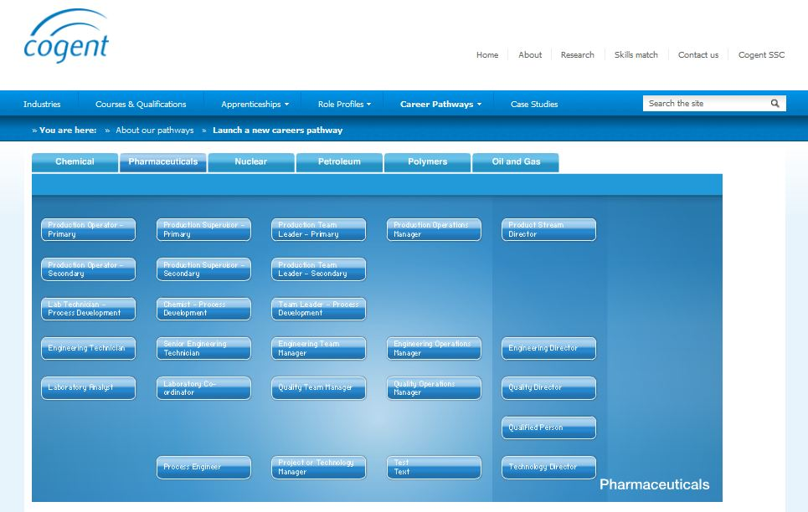
Careers in Pharmaceuticals

Slide 5
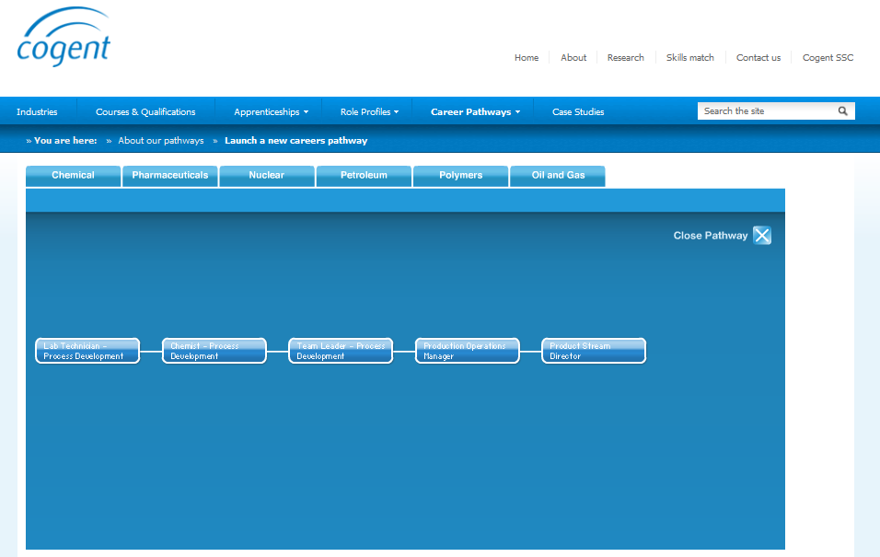
Lab Technician
Process Development

Slide 6
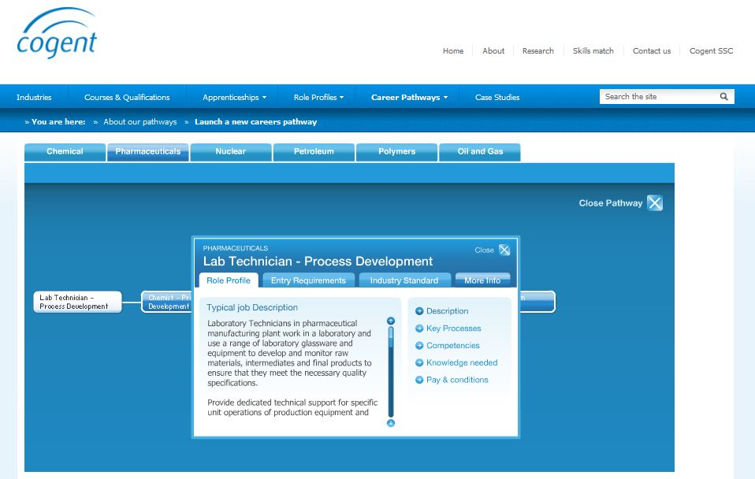
Lab Technician
Process Development

Slide 7
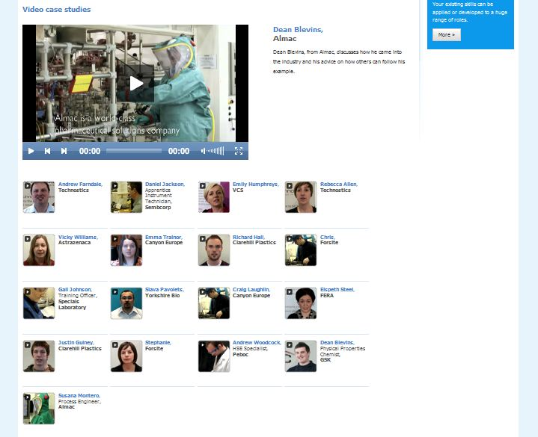
Case studies

Slide 8
Career and Training Pathways
COLLABORATION,
COLLABORATION,
COLLABORATION

Slide 9
Bioscience disciplines
Agriculture
Virology
Taxonomy
Systems Biology
Sport and Exercise Science
Plant Science
Physiology
Pharmacology
Neuroscience
Nanobiology
Molecular Biology
Microbiology
Marine Biology Immunology
Anatomy (pre-clinical)
Animal Science
Biochemistry
Bioinformatics
Biophysics
Biotechnology
Cell Biology
Developmental Biology
Ecology
Evolutionary Biology
Food Science and Technology
Genetics

Slide 10
Society of Biology
56 full member organisations e.g.
  Biochemical Society
  British Pharmacological Society
  British Society for Immunology
  Genetics Society
  Society for Experimental Biology
  Society for General Microbiology
  The Physiological Society
20 supporting organisations e.g.
  ABPI
  BBSRC
  MRC
  Wellcome Trust

Slide 11
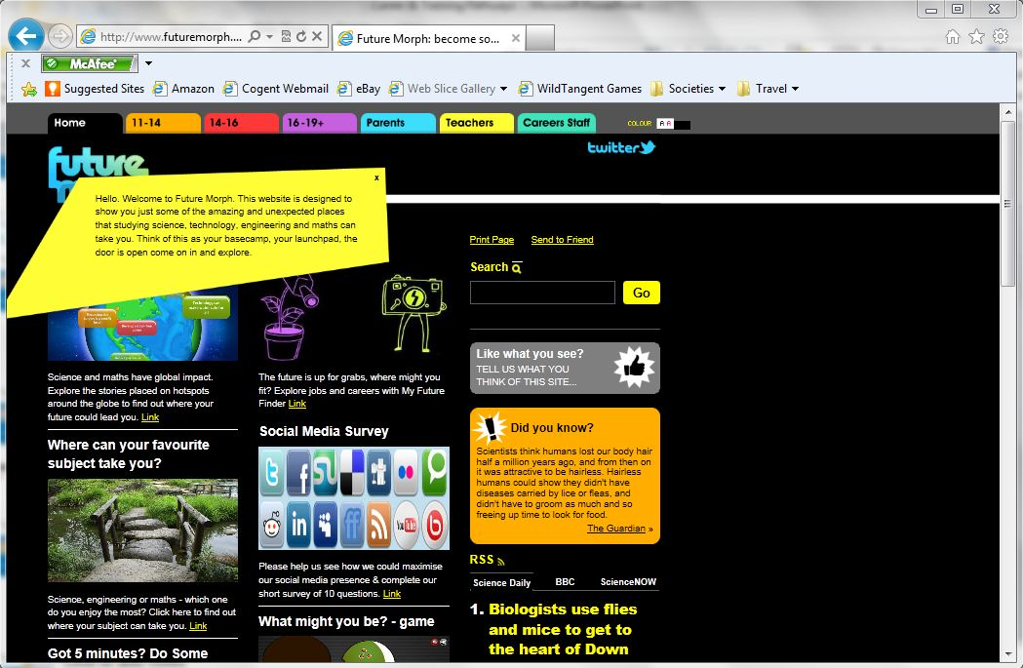
Science Council: future morph

Slide 12
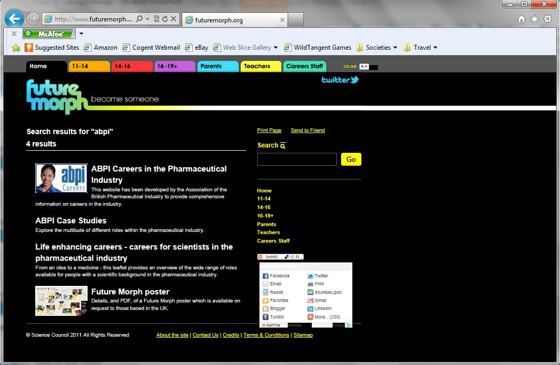
future morph links to ABPI

Slide 13
Career and Training Pathways
State of the art technology/approaches

Slide 14
Life Sciences Skills Pathways
Graduate Employability
‘Bioenterprise Gold Standard’- VOLUNTARY
  protecting, researching, developing, funding ideas
  creative problem solving
  business improvement, planning
  regulation, H & S, ethics
  inter-personal skills

Slide 15
Title Area
Subtitle Area

