Slide 1

Applied Bioscience Technology Foundation Degree
Iain Cumming, Academic Lead
Pauline Maden, Project Manager
(Brian Szukala, Industry Champion)

Slide 2
Background
HEFCE funded
Collaborative partnership
Opportunity to do things differently
22+ companies consulted
Aligned to key business drivers

Slide 3
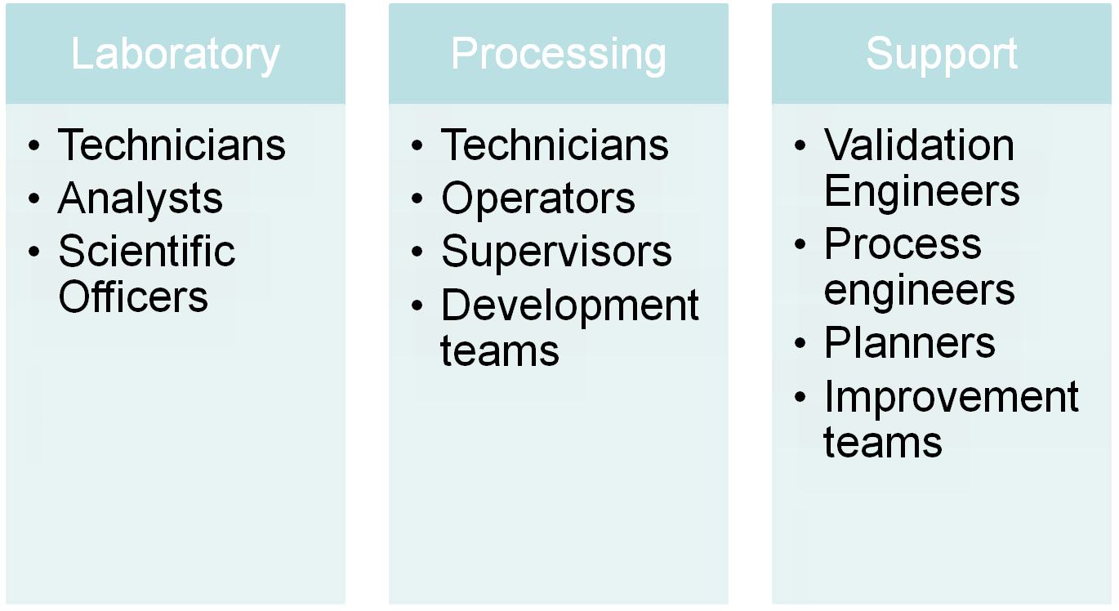
Target Groups

Slide 4
Industry Feedback
Flexible delivery mode
New Learning opportunities
Internal accreditation
Clear business benefits
Short course options

Slide 5
Applied Bioscience Technology Fd
Aimed at upskilling/reskilling in R&D and manufacturing
Recruiting for a January 2012 start
Higher Level Apprenticeship Framework

Slide 6
Framework outline

Slide 7
Flexible Delivery
Recognise/accredit internal learning
E-learning
Workbased learning activities
Online Learning Forums
Summer School

Slide 8
Syllabus
Science Modules
Technical Skills
Industry focused modules
Online PDP
Work based project

Slide 9
Basic and specialist science modules include
  Microbiology
  Cell biology
  Applied Chemistry
  Biochemistry
  Infection and Immunity
  Metabolism and Enzymology
  Human Physiology and Disease
  Applied Microbiology
Industry modules
  Technology transfer
  Business improvement
  Good pharmaceutical practice (GxP)

Slide 10
E-learning materials
http://www.workforcedevelopment.fdf.ac.uk/

Slide 11
Workbased Project
Linked to course theory
Application of learning
Aligned to internal company systems
Added value to student and company (Real problems & solutions)

Slide 12
www.workinghigher.org
Iain Cumming
K.I.Cumming@greenwich.ac.uk
Brian Szukala
brian@tknp.org.uk
Pauline Maden
pauline.maden@cogent-ssc.com

Slide 13
Thank You
Questions

