Slide 1

Life Sciences Advisory Council
Nigel Brooksby
Chair

Slide 2
Agenda
Welcome and Introduction
Nigel Brooksby, Chair
Presentations from LAC Working Groups
Chairs of Working Groups
Update from the Office and Life sciences
David Griffiths-Johnson, BIS
Update on GIF/EIF 1 bids and ideas for GIF 2
John Holton, Cogent SSC
Launch of the Working Higher Programme (Life sciences)
Iain Cummings, Kent University
Thanks and Close
Joanna Woolf, Cogent SSC

Slide 3
Attendees
Antonis Papasolomontos BioIndustry Association
Brian Szukala Transfer Knowledge Partners
Carl Naraynassamy Accovion Ltd
Carol Richmond Belfast Metropolitan College
Caroline Sudworth Cogent
Clare Bhunnoo BBSRC
Darren Race SEMTA
David Adams Cogent
David Bowman Lilly UK
David Griffiths-Johnson BIS
Gavin Brooks University of Reading
Glenn Crocker Biocity
Iain Cummings Kent University
Ian Little Cogent
Jane O'Brien Department of Health
Jeremy Hinks University of Southampton
Jim Gazzard The Royal Veterinary College
Joanna Woolf Cogent
John Holton Cogent
John Ponser John Ponser Consulting
Karen Booth BIS
Kate Hutchins Cogent
Kevin Thrower National Skills Academy
Process Industries
Laura Bellingan Society of Biology
Lesley Earl Huntingdon Life Sciences
Lesley Galloway Ethical Medicines
Industry Group
Linnea Larsson Medical Research Council
Lynda Wight TOPRA
Madge Moore Lantra
Mark Downs Society of Biology
Nick Fayers Lancaster University
Nigel Brooksby Cogent
Pauline Maden Cogent
Philip Kendall One Nucleus Limited
Richard Reece University of Manchester
Richard Thompson Royal College of
Physicians
Shirley Price University of Surrey
Stuart West Biocatalysts Ltd
Tina Sawyer Cogent

Slide 4
Apologies
Clive Page King's College London
Daniel Smith HealthTech and Medicines KTN
Doris-Ann Williams British In Vitro Diagnostics Association
Harry Kelly GlaxoSmithKline
Karen McCann University of Ulster
Malcolm Skingle GlaxoSmithKline
Marie-Noelle Gagnon Novartis
Mario Moustras Royal Society of Chemistry
Mark Lloyd Davies Janssen-Cilag Ltd
Rachel Stewart University of Reading
Rhoswyn Walker Medical Research Council
Rob Pinnock Merck Sharp & Dohme
Sarah Jones The Association of British Pharmaceutical Industry
Simon van Heyningen University of Edinburgh
Trevor Jones
Wendy Livingstone Forth Valley College

Slide 5

Keeping up the pace and looking forward
Together we are working on a comprehensive set of measures to improve the skills environment in the UK, improve sector competitiveness and deliver a highly professional workforce, ready for future growth

Slide 6
Chairman’s Report
We are listening to you. What you say is important to us
We have interpreted what you have said and we have made sure that we have included your priorities in our bids to secure the future funding for delivery.
Winning bids will provide the essential resources to translate the challenges and ideas into solutions.

Slide 7
Chairman’s Report
Progress to date
You identified four key priorities from the Action Plan and from our discussions at the Life sciences Advisory Council. Namely, Technician Training (Apprenticeships), Skills Signals, Placements and an offer for SME’s
We have established four Working Groups to deliver on the four priorities and all of you will have had the opportunity to join one or more of the Working Groups. Led by Malcolm Skingle (Placements) Jackie Wilbraham (Skills Signals) and Lesley Earl (Apprenticeships/Technician Training) and with BIA, EMIG and ABHI actively participating and supporting the SME Working Group.
Meetings have taken place and Terms of Reference have been established. A set of clear priorities have been agreed for each group.

Slide 8
Working Groups Delivering on Employer’s Priorities:
Early Deliverables
SME’s: We will develop a Management and Leadership offer including a Mentoring Programme that is complimentary to existing provision by June 2012.
Skills Signals: We will work with employers in the life sciences sector to capture best practice and develop an outline Employability Framework by spring 2012
Apprenticeships/Technician Training: We will have a Higher Level Apprenticeship and accredited Foundation Degree in place by the end of the year, ready for the first apprentice to start in January 2012.
Placements: We will engage with Professor Sir Tim Wilson and a range of Professional Bodies and provide input to his Review on Industry engagement with Higher Education. We will discuss the effects of tuition fees on undergraduate placements and make recommendations to the LAC by Spring 2012.

Slide 9
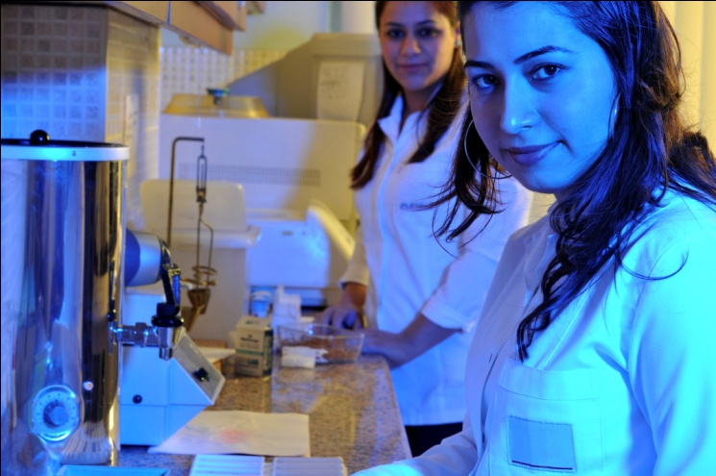
One Voice
These achievements are and will be testament to the rapid impact made by the Life sciences Advisory Council and the Life sciences Skills Strategy Board. They demonstrate what we can accomplish through genuine collaboration-when industry and academia work closely together, and when employers speak with one voice.

