Slide 1

Life Science
“Window on the world”.
April 2012

Slide 2
Background to the Skills Gateway
Ambition: to develop web-based Skills portal as the “window on the world” of life sciences.
To engage and integrate the community of employers and stakeholders through the portal
To promote and accelerate skills solutions, products and services.
Develop an online skills and resources shop.
Cogent secured some seed funding to develop concept, from UKCES Employer Investment Fund

Slide 3
Milestones
Establish employer /stakeholder group
Develop and market test demand and value for access and use of Gateway
Road test platform prototype through focus groups
Implementation and soft launch
Dissemination
Feedback and refinement

Slide 4
Site resources- tool and services
Apprenticeships
Placements (potential GIF bid)
Mentoring (potential GIF bid)
SME skills needs and gaps analysis tool
Commercial research
E-shop for skills solutions and courses.
Funding advice and signposting
Career pathways

Slide 5
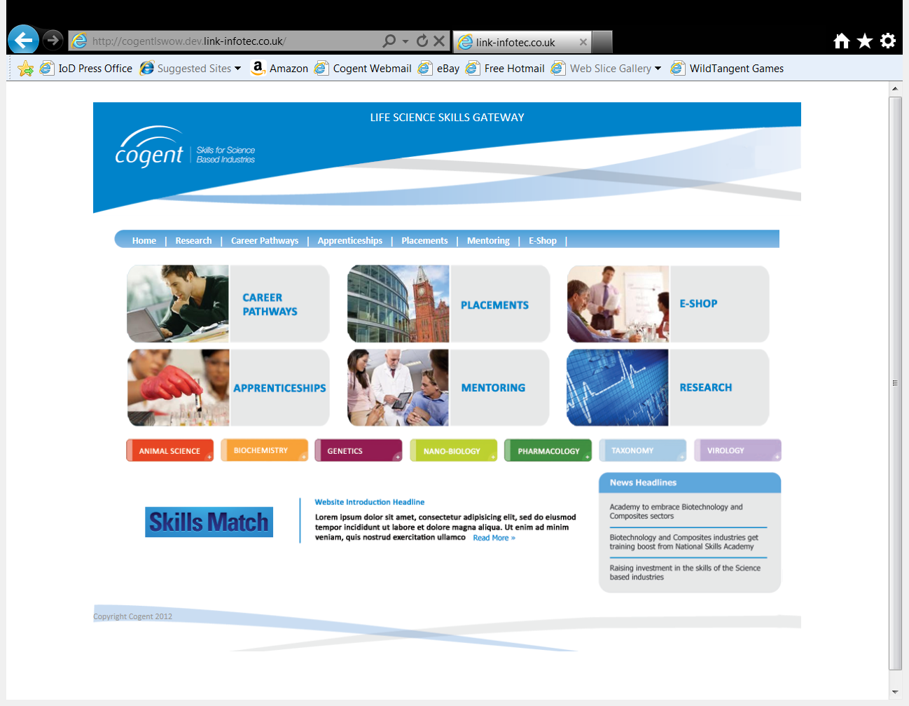

Slide 6
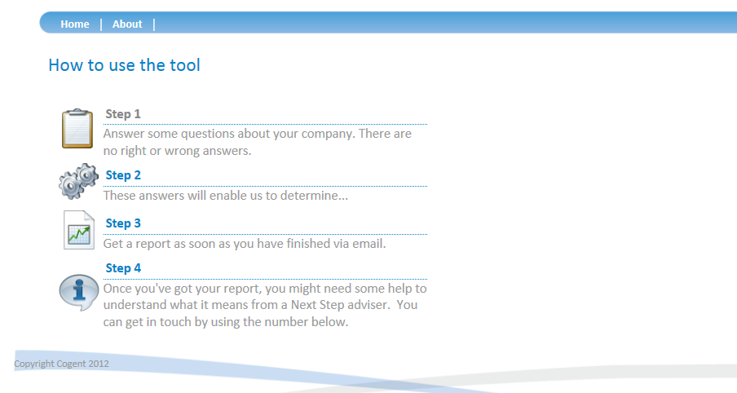
Skills Match (SME Diagnostic Tool)

Slide 7
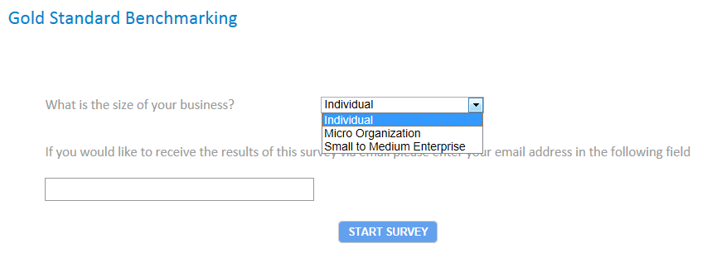
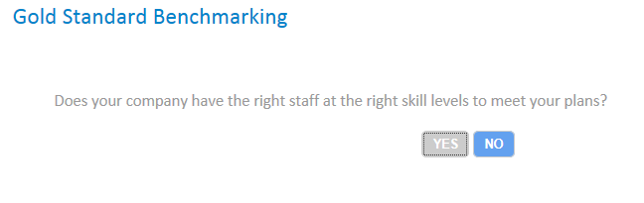
Skills Match (SME skills diagnostic tool)

Slide 8
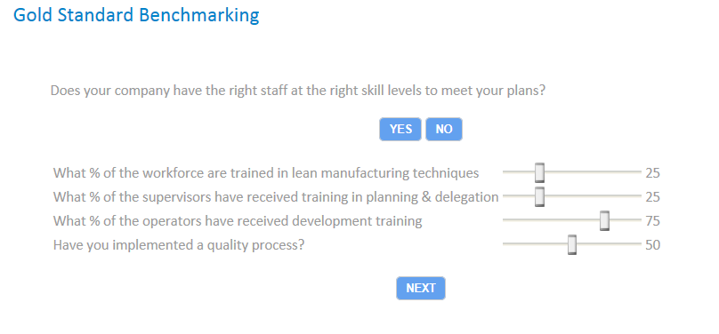
Skills Match (SME Skills Diagnostic Tool)

Slide 9
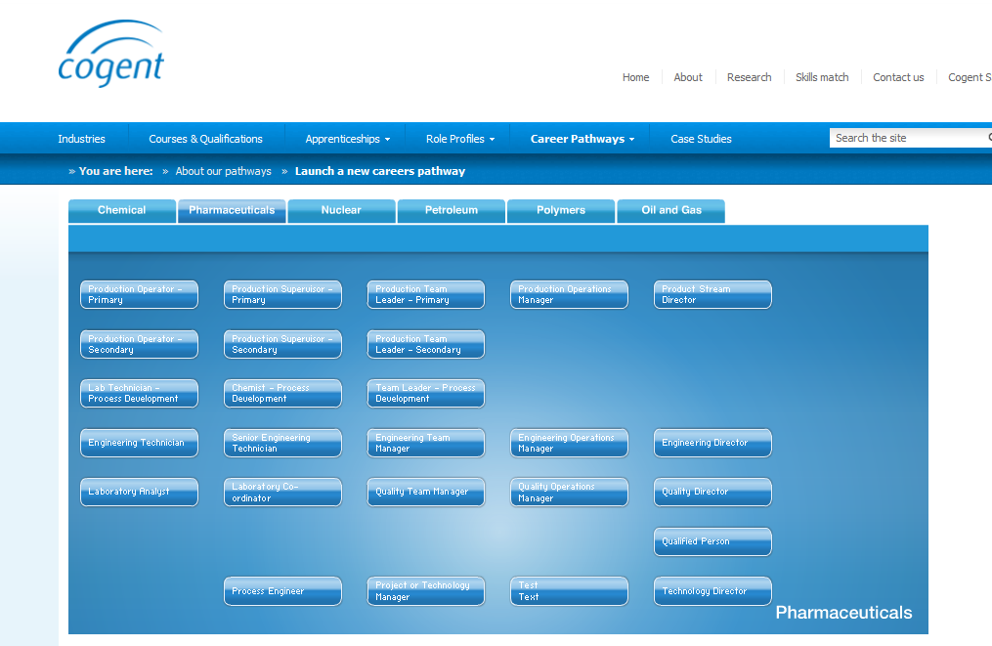
Existing pharma pathways

Slide 10
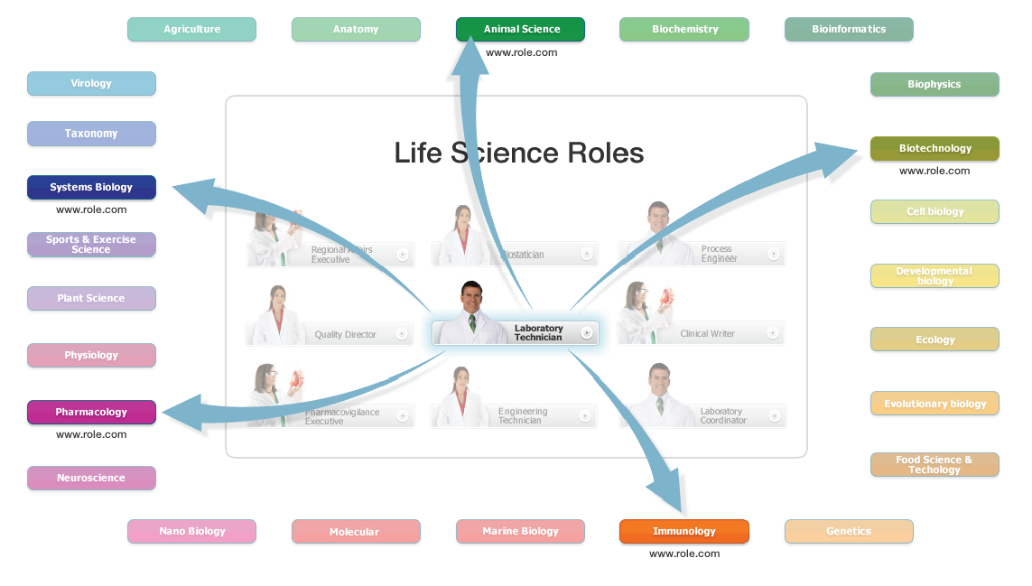
Potential new Life Science pathways

Slide 11
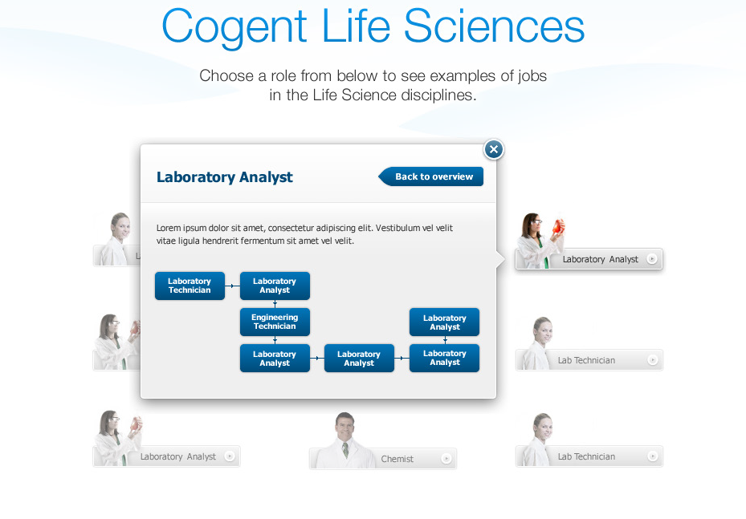

Slide 12
Future and sustainability
Build and maintain a flexible web system responsive to sector needs
Potential for Sponsorship, advertising, recruitment
Future development through LAC and LSSB and the Working Groups.

