Slide 1

Apprenticeships
Working Group Summary
September 2011

Slide 2
Apprenticeships
Chair – Lesley Earl, Huntingdon Lifesciences
Members
  Matthew Al'affineur- GSK Nicki Millward - Astra Zeneca
  Brian Szukala – Trans’ Knowledge Partners Michael Glyn - Lilly
  Rachel Cashman - Pfizer Helen Hughes - GSK
  Rachel Forsyth - Society of Biology Karen Olney - NAS
  Peter Grice – PAA\VQSET Vicki Barwick - LGC
  Bev Cooper - 3M Healthcare Darren Ladd - Genzyme
  Helen Hughes - Edenbiodesign Steve Flatman – Lonza
  Ellen Patrick - Wirral Met
Terms of Reference proposed

Slide 3
Apprenticeships
Terms of Reference
The Apprenticeship Working Group has been established to facilitate a working discussion between employers, government and trade associations and to develop apprenticeships at all levels across the Life sciences sector.
To this aim, the Group will consider the needs of employers across the sector and map provision to develop a fit for purpose technician training offer
It will review the range of existing training and encourage stakeholders to work together to develop flexible delivery solutions that capture best practice and achieve value for money.
It will provide a forum to develop ONE VOICE on skills for employers in the life science industry discussing the skills that the sector needs and developing a collaborative approach to deliver technician training.
It will provide commentary and support for Cogent’s bids to the EIF and GIF funds. With the shared ambition of improving the quality of skills provision and workforce development, and to support the continued growth and prosperity of SME’s.

Slide 4

Apprenticeships
Overall objective is to provide pathways to a ‘professional technician’
  develop a High Level Apprenticeship (HLA)
  launch a life sciences Foundation Degree
  develop a HLA framework with various pathways

Slide 5
Apprenticeships
Overall objective is to provide pathways to a ‘professional technician’
Develop a High Level Apprenticeship (HLA)
  Launch a life sciences Foundation Degree
  Develop a HLA framework with various pathways
Develop an Advanced Apprenticeship for life sciences
  Laboratory Science (with pathways?)

Slide 6
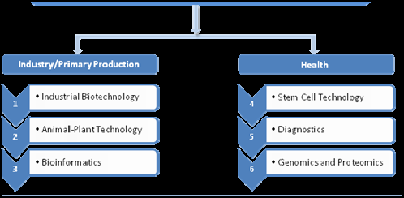
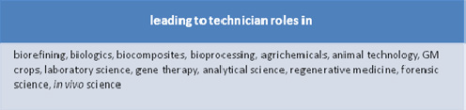
High Level Apprenticeship Framework

Slide 7

Apprenticeships
Progress to date
Mapping Life Science Industry roles against the different level Apprenticeship Frameworks has commenced.
Interest has been shown from a range of companies in the Higher Level Apprenticeship for Life Science.
Flexible Apprenticeship delivery solutions are being developed.
The first Apprenticeship Working group meeting will take place in October.

Slide 8

Apprenticeships
Objectives and Delivery
We will have a Higher Level Apprenticeship and accredited Foundation Degree in place by the end of the year ready for the first apprentice to start in January 2012

