Slide 1

Life Sciences Advisory Council Sub Groups
John Holton
September 2011

Slide 2
Life Sciences Action Plan
To address urgent need immediate action will be taken to:
resolve actions on skills signals across employers and universities
seek new ways to address urgent skills gaps
deliver exemplar vocational pathways to higher education
brokering laboratory placements
In the medium term a broader series of actions for development are proposed:
better utilisation of pathways to professional status
embedding leadership and management
articulate a clear vision of careers for the sector
future skills demands of the bio-economy in general
Sub Group
Skills Signals
Apprenticeships, Skills Signals
Apprenticeships
Placements
Skills Signals, Apprenticeships
SME offer
Career Pathways
EIF2 bid

Slide 3
LAC Sub Groups
Four sub groups
  Skills Signals
    Chair – Jackie Wilbraham, AZ
  Apprenticeships
    Chair – Lesley Earl, Huntington
  SME Offer
    Chair Tina Sawyer, Cogent
  Placements
    Chair - Malcolm Skingle, GSK
Terms of Reference agreed for each sub group

Slide 4
Skills Signals
Objective: To develop a skills signalling mechanism for the Life Sciences Community. Initial focus is on Pharmaceuticals and medical biotechnology
Actions
Discussions with Employers across the Sector to map the landscape and establish need - graduate and postgraduate provision
  Funding sort through our EIF2 bid
Developing an Outline Framework for agreement by Spring 2012
  NHS, Emtrain, Vitae Researcher
  kite marking & graduate employability standards
LSSB support
  provide input to action 1
  feedback on draft framework

Slide 5
  Apprenticeships
Objective: to provide pathways to a ‘professional technician’
  Actions
Launch a life sciences Foundation Degree
  November 2011
Develop a High Level Apprenticeship (HLA)
  Start date January 2012
Develop a HLA framework with various pathways
  Included in Cogent’s successful GIF bid
LSSB support
  Direct engagement of Board members to the pilot HLA – 9 places
  Board members to promote take-up of the life sciences FD

Slide 6
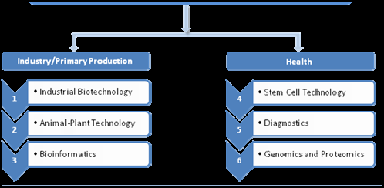
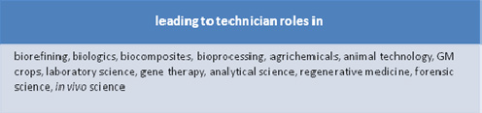
High Level Apprenticeship Framework

Slide 7
SME Offer
Objective: To develop a fit for purpose training offer for SME’s in the Life sciences Sector
  Actions
  Review the existing SME training and mentoring programmes, and develop a fit for purpose training offer
  funded by our successful EIF1 bid (7 workshops planned for autumn/spring)
  completion March 2012
  Review the range of existing provision and work with providers to capture best practice and achieve value
  LSSB support
  Initiate involvement of SMEs (supply chain) to ensure the offer is truly value adding and will be taken-up

Slide 8
Placements
Objective: To develop a an increase in placements of various forms across the Life sciences sector
Placements include: undergraduate, postgraduate, internships & academic/industry exchange programmes
Actions
Engagement with Professor Sir Tim Wilson Review of Industry engagement with Higher Education in October/ November 2012
To develop a viable placement offer
  test a placement proposal with employers Q4 2011
  consider a GIF2 bid to develop the placement programme
LSSB support
  to review the placement proposal and feedback

